Slide 1
Clifton Corridor Transit Initiative
Presentation to Druid Hills Civic Association
June 20, 2018

Slide 2
agenda
Background – Where we started
Current – Where we are now
Next steps – Where we’re going
Neighborhood – Project Context
Discussion

Slide 3
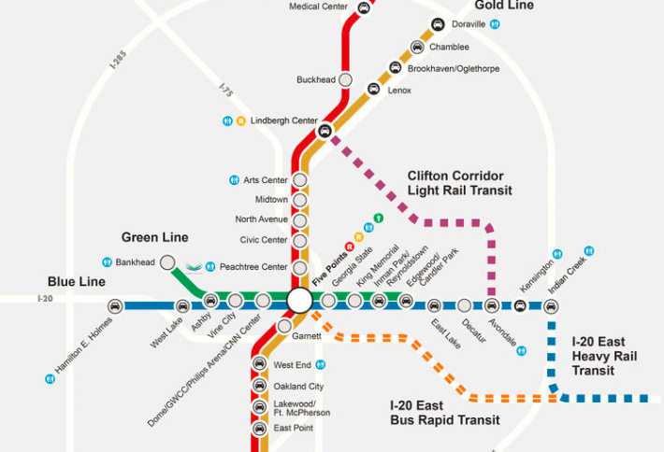
Regional transit Context
Light Rail from Lindbergh Center station to Avondale station
Links Red/Gold line to Blue Line
High capacity transit service to a major regional job center
Reliable, frequent transit in a highly congested area
Serves Atlanta, DeKalb County and regional commuters
CDC/Emory area

Slide 4
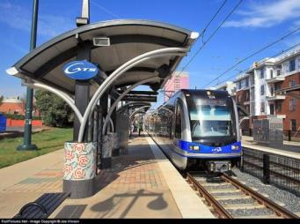
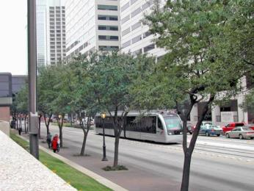
What is light rail transit?
Light Rail Vehicles: Similar or same as modern streetcar, but typically 2 or more cars per train providing higher capacity
Flexibility: Operates along roadways typically in exclusive lanes, and may include dedicated guideways at ground level, elevated, or underground
Operations: Stops typically ½ to 1 mile, but can be closer in major activity areas; frequency typically every 5 to 15 minutes throughout the day
Stations/Stops: Simple stations with center or sidewalk-level platforms
Power System: Electric power is generally via overhead wires, rather than by third rail
Light Rail in a dedicated guideway (Charlotte)
Light rail operating with the roadway (Houston)

Slide 5
Project history
2009
2009
2009
2012
2012
2012
2013
2013
2014
2014
2014
2015
2015
2015
2016
2016
2016
2017
2017
2013
2017
2018
2018
2018
Alternatives Analysis:
Evaluated potential project alignments (routes) and transit types
Analysis + stakeholder input: reduce potential alternatives to a best alignment + transit type
Outcome: Light Rail Transit from Lindbergh Center to Avondale
Refinements + Subsequent Alternatives:
Improved project design
Improved transit reliability and frequency
Improved access to jobs and activity centers
Responded to stakeholder concerns
Improved traffic flow
Improved cost-competitiveness for federal funding
Outcome: Two alternatives for Environmental Impact Statement (EIS)
Environmental Review and Documentation:
Transportation Operations & Impacts
Community Resources
Natural Resources
Cumulative and Constructions
Outcomes:
Recommended Alternative
Publication of Draft EIS (2019)

Slide 6
Considerations for the Preferred Alternative
Cost & Feasibility: Cost must be affordable and cost-effective in order for the project to be feasible and competitive for federal funding.
Accessibility & Reliability: The project must provide reliable service, frequent travel times, and convenient, accessible stations.
Project Impacts: Impacts are unavoidable and are mitigated to balance tradeoffs between aspects such as access, traffic, property and cost.
Support: The project must achieve support of the community, stakeholders and public agencies in order to succeed.

Slide 7
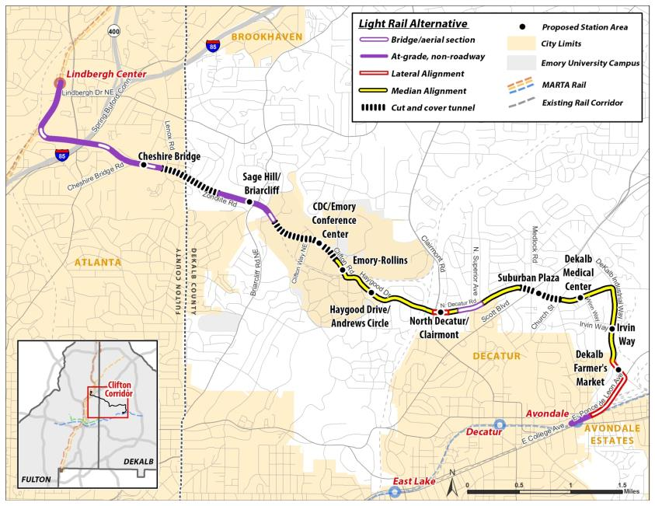
Preferred alternative: general overview
Total Length: 8.3 Miles
Three tunnel sections
Frequency: Every 7.5 minutes during AM and PM rush (peak periods)
End to end travel time: 26.5 minutes
10 New Stations . . . 2 underground
Walk-up station platforms provide convenient user access
New light rail platforms at Lindbergh Center and Avondale stations
CUT AND COVER
TUNNEL SECTIONS
ADJACENT TO
EXISTING MARTA/CSX
CDC/EMORY AREA:
CLIFTON RD + HAYGOOD DR
N DECATUR RD
DEKALB INDUSTRIAL WAY +
E PONCE DE LEON AVE

Slide 8
Current project status
Environmental documentation – Nearing completion of federally required environmental documentation (EIS).
Corridor development and growth continues – Lindbergh Center, Cheshire Bridge Road, Emory University, Suburban Plaza, Avondale TOD. Additional demand on roadway network.
More MARTA sales tax – anticipated local funding for first phase within City of Atlanta (Lindbergh Center to Emory area).

Slide 9
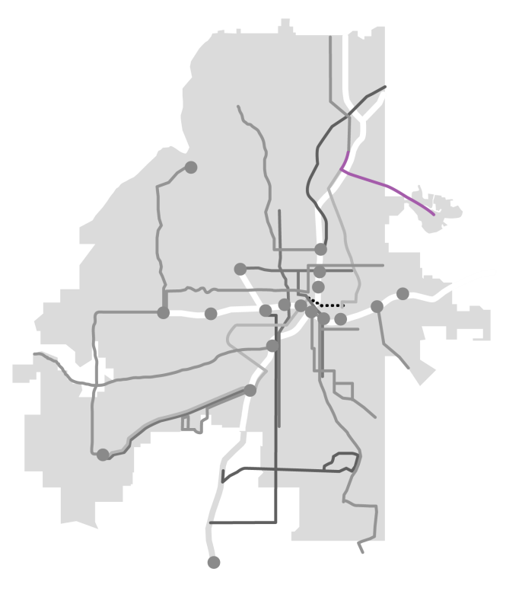
More Marta Atlanta
Program: City of Atlanta Sales Tax Funding Transit Improvements
MARTA Board to adopt recommended project list in Fall 2018
Clifton Corridor project remains Lindbergh Center to Avondale
City of Atlanta will be able to fund a potential first phase within City of Atlanta
Proposed funding for Clifton light rail:
$500 MM Local Funding Share
Anticipated 50% Federal Share
Any extension beyond City of Atlanta dependent on other local funding sources
ATLANTA
DEKALB
COUNTY
Clifton Corridor
Light Rail

Slide 10
Phase 1 – potential schedule
Next Steps:
Public and stakeholder outreach: determine best alternative and phasing
Complete environmental documentation and publish EIS
Begin project development for federal funding
Engineering

Slide 11
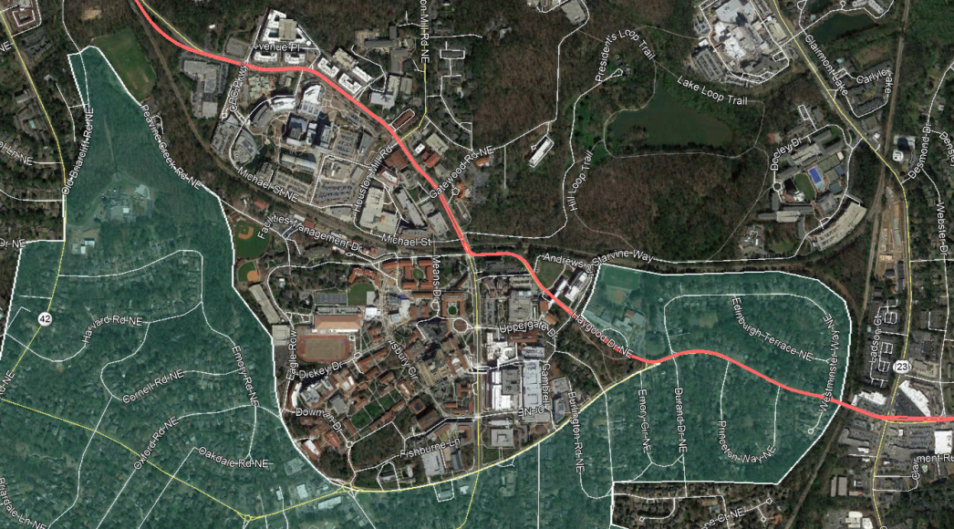
Druid Hills Neighborhood context map
CDC/ EMORY
CONFERENCE CENTER
STATION (BELOW-GRADE)
Tunnel Section
Gatewood Dr
EMORY-ROLLINS
STATION (AT-GRADE)
Haygood Dr
Clifton Rd
EMORY GROVE
HISTORIC DISTRICT
Clairmont Rd
DRUID HILLS
HISTORIC DISTRICT
ANDREWS CIRCLE
STATION (AT-GRADE)
At-Grade (Median
Alignment) Section
N Decatur Rd
N DECATUR/CLAIRMONT
STATION (AT-GRADE)

Slide 12
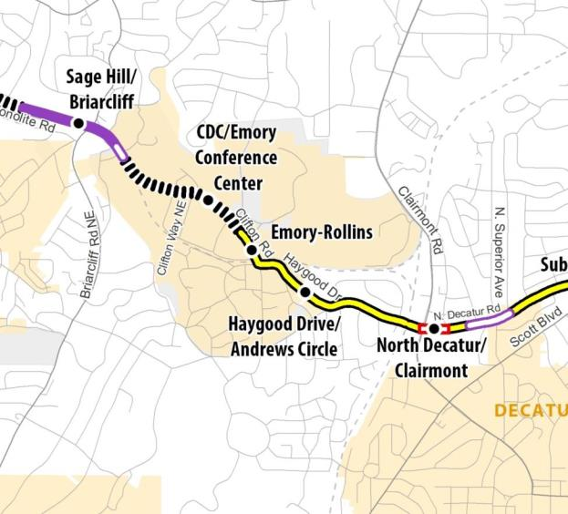
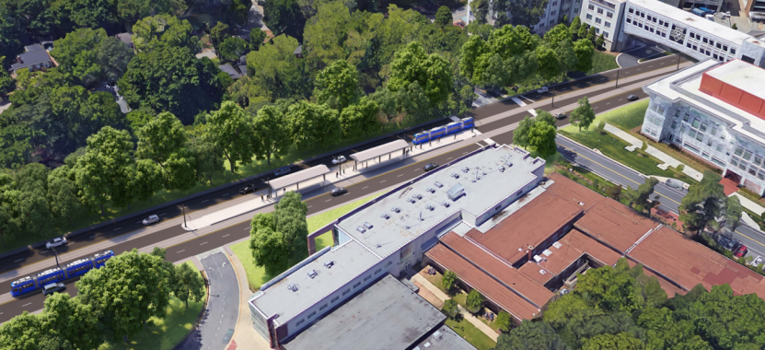
CLIFTON ROAD TO North decatur Road
Stations serve CDC, Emory-Rollins, and Emory University and Hospital
Tunnel under Clifton Road from CDC Parkway to Gatewood Road
Light rail in exclusive median lanes on Clifton Road and Haygood Drive to North Decatur Road

Slide 13
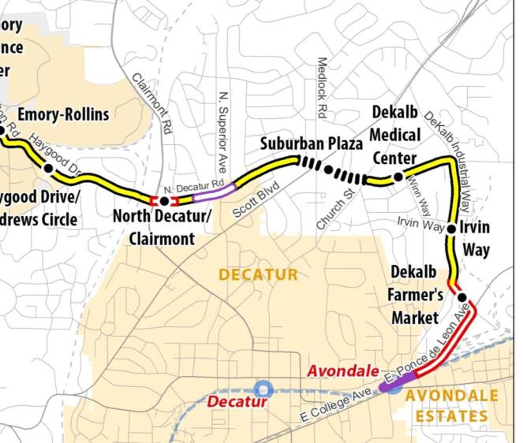
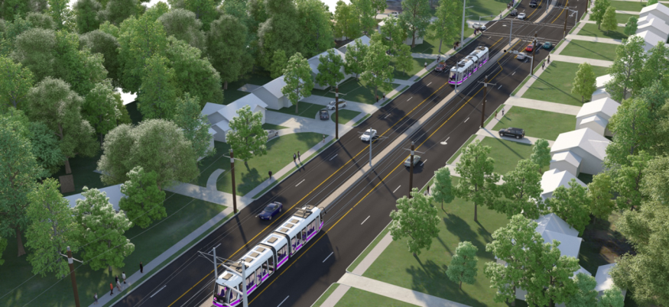
North Decatur Road
Light rail in exclusive median lanes on North Decatur Road from Haygood Drive to DeKalb Industrial Way
North Decatur Road widened to provide adequate right-of-way
Stations at Clairmont Road, Suburban Plaza, and DeKalb Medical Center
Aerial section over creek and Superior Avenue east of Clairmont Road
Tunnel under Scott Boulevard/ Medlock Road intersection through Church Street – no rail through these intersections

Slide 14
Transit travel times
Estimated travel times between Druid Hills area and LRT termini
Druid Hills Area Stations
Lindbergh
Center
Avondale
15 min.
N Decatur/
Clairmont
12 min.
11.5 min.
Andrews
Circle
15.5 min.
8.5 min.
Emory-
Rollins
18 min.
7 min.
CDC/Emory
Conf. Center
20 min.

Slide 15
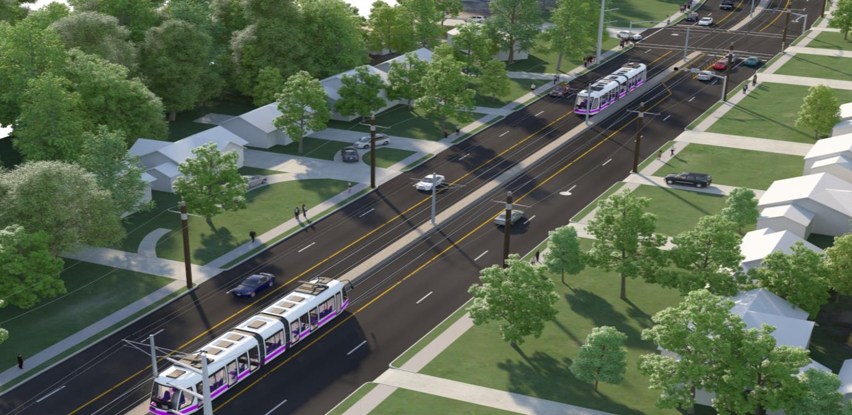
Druid Hills Area considerations
End of Line station for first phase: Haygood vs North Decatur/Clairmont
North Decatur/ Clairmont is preferred
Changes to North Decatur Road east of Haygood Drive:
Property Impacts
Access Changes
Left turn
Approx. existing
property lines

Slide 16
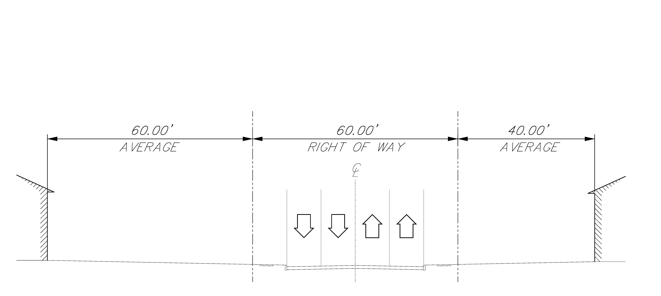
North decatur road: emory grove segment N. Decatur Road existing conditions
YARD (North)
YARD (South)
CURB TO CURB
(40-45 feet)

Slide 17
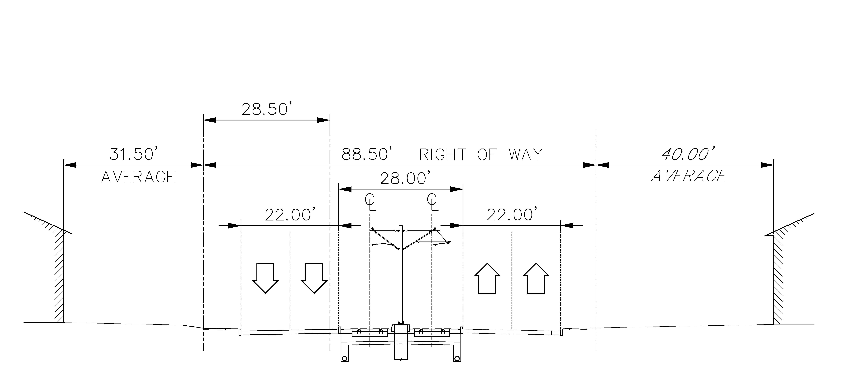
North decatur road: emory grove segment N. Decatur Road median alignment with widening to north
EXTENDED
AREA
YARD (North)
WEST-
BOUND
TRAFFIC
EAST-
BOUND
TRAFFIC
YARD (South)
LIGHT RAIL
(in median)
CURB TO CURB

Slide 18
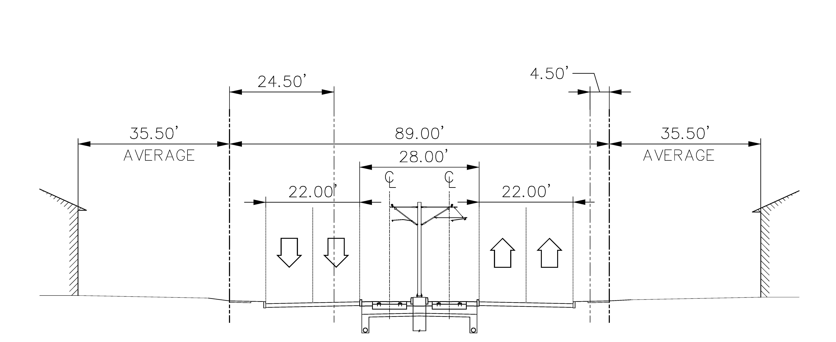
North decatur road: emory grove segment N. Decatur Road median alignment with widening on both sides
EXTENDED
AREA
EXTENDED
AREA
YARD (North)
WEST-
BOUND
TRAFFIC
EAST-
BOUND
TRAFFIC
YARD (South)
LIGHT RAIL
(in median)
CURB TO CURB

Slide 19
How you can get involved
Opportunity | Detail
Clifton Corridor Website | https://www.itsmarta.com/clifton-corridor-overview.aspx Project information, factsheets, newsletters, and event announcements
Additional Neighborhood Meetings | We will be back to discuss the project with each neighborhood group, including workshops to discuss issues and solutions in each area.
Project Webinar | July – date to be determined
Email the Project Team | clifton@itsmarta.com
Email announcements | If you signed in today, you will receive project announcements and updates. If you did not sign in and would like to receive this information. please email MARTA at clifton@itsmarta.com.
Public Events | Look for Clifton Corridor booths at upcoming festivals. Next Event: Callanwolde Jazz on the Lawn – June 29
Public Comment Period & Public Hearing | Public comments can be made for 45 days following publication of the DEIS. A public hearing will be held two to six weeks after DEIS publication. Comments received during this time will be incorporated into a Final EIS (FEIS).

Slide 20
Questions?
Project Contact: Bryan Hobbs, MARTA Project Manager
jhobbs@itsmarta.com

