Slide 1
Stakeholder Meeting November 18, 2021 State Route 8 Ponce de Leon Avenue Safety Projects

Slide 2
Virtual Stakeholder Meeting via Microsoft Teams
Goals for Today’s Discussion
Provide updated conceptual drawings of two intersections
Obtain feedback on layouts via:
Stakeholders take notes of input and feedback
Stakeholders submit their input via email after the meeting
Raise Hand or post comment in Teams Meeting
Provide verbal input
Ask verbal questions about layouts

Slide 3
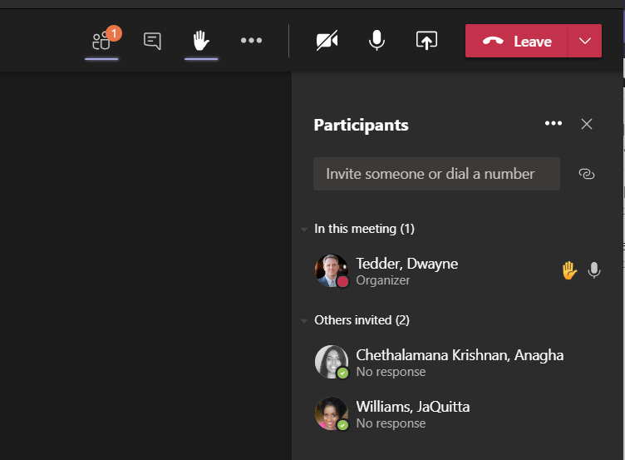
Virtual Stakeholder Meeting via Microsoft Teams
Obtain feedback on layouts via:
Raise Hand in Teams Meeting

Slide 4
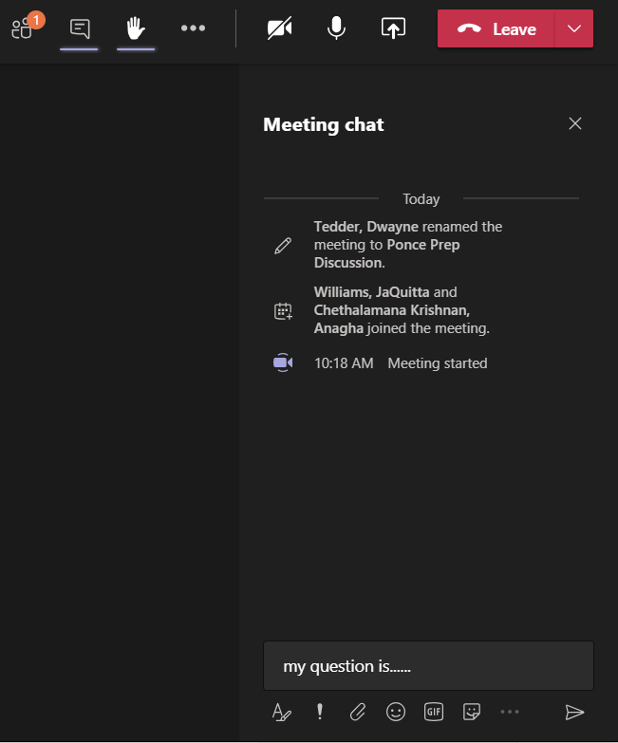
Virtual Stakeholder Meeting via Microsoft Teams
Obtain feedback on layouts via:
Type Comment in Teams Meeting

Slide 5
GDOT Federal Programs
Safety Program
The Safety Program has projects that are programmed to address specific issues
The Safety Program’s focus is to achieve GDOT’s goal of zero deaths and reduce the number of crashes on Georgia roadways by engaging our community using data and best practices to implement safety countermeasures that effect all modes of transportation.
The Safety Program has budget constraints and must meet certain qualifications for Safety Federal Funding.

Slide 6
GDOT Safety Program
Safety Program
Data Driven
Qualifications Based
Improve Safety on Roads by performing:
Studies
Road Safety Audits
Maintenance Work
Projects
Constraints such as Environmental Laws

Slide 7
GDOT Conducted Stakeholder Meetings for SR 8 / Ponce de Leon Avenue
February 6, 2019 – GDOT met with stakeholders to discuss the overall corridor and its needs
May 2, 2019 – GDOT presented stakeholders with crash data and locations for continued study and monitoring
September 28, 29, and 30, 2020 – GDOT presented stakeholders with alternatives considered for various locations along the corridor
October 12, 2021 – GDOT met with local governments and politicians to discuss two large intersection projects

Slide 8
SR 8 / Ponce de Leon Avenue Intersection Improvement Projects

Slide 9
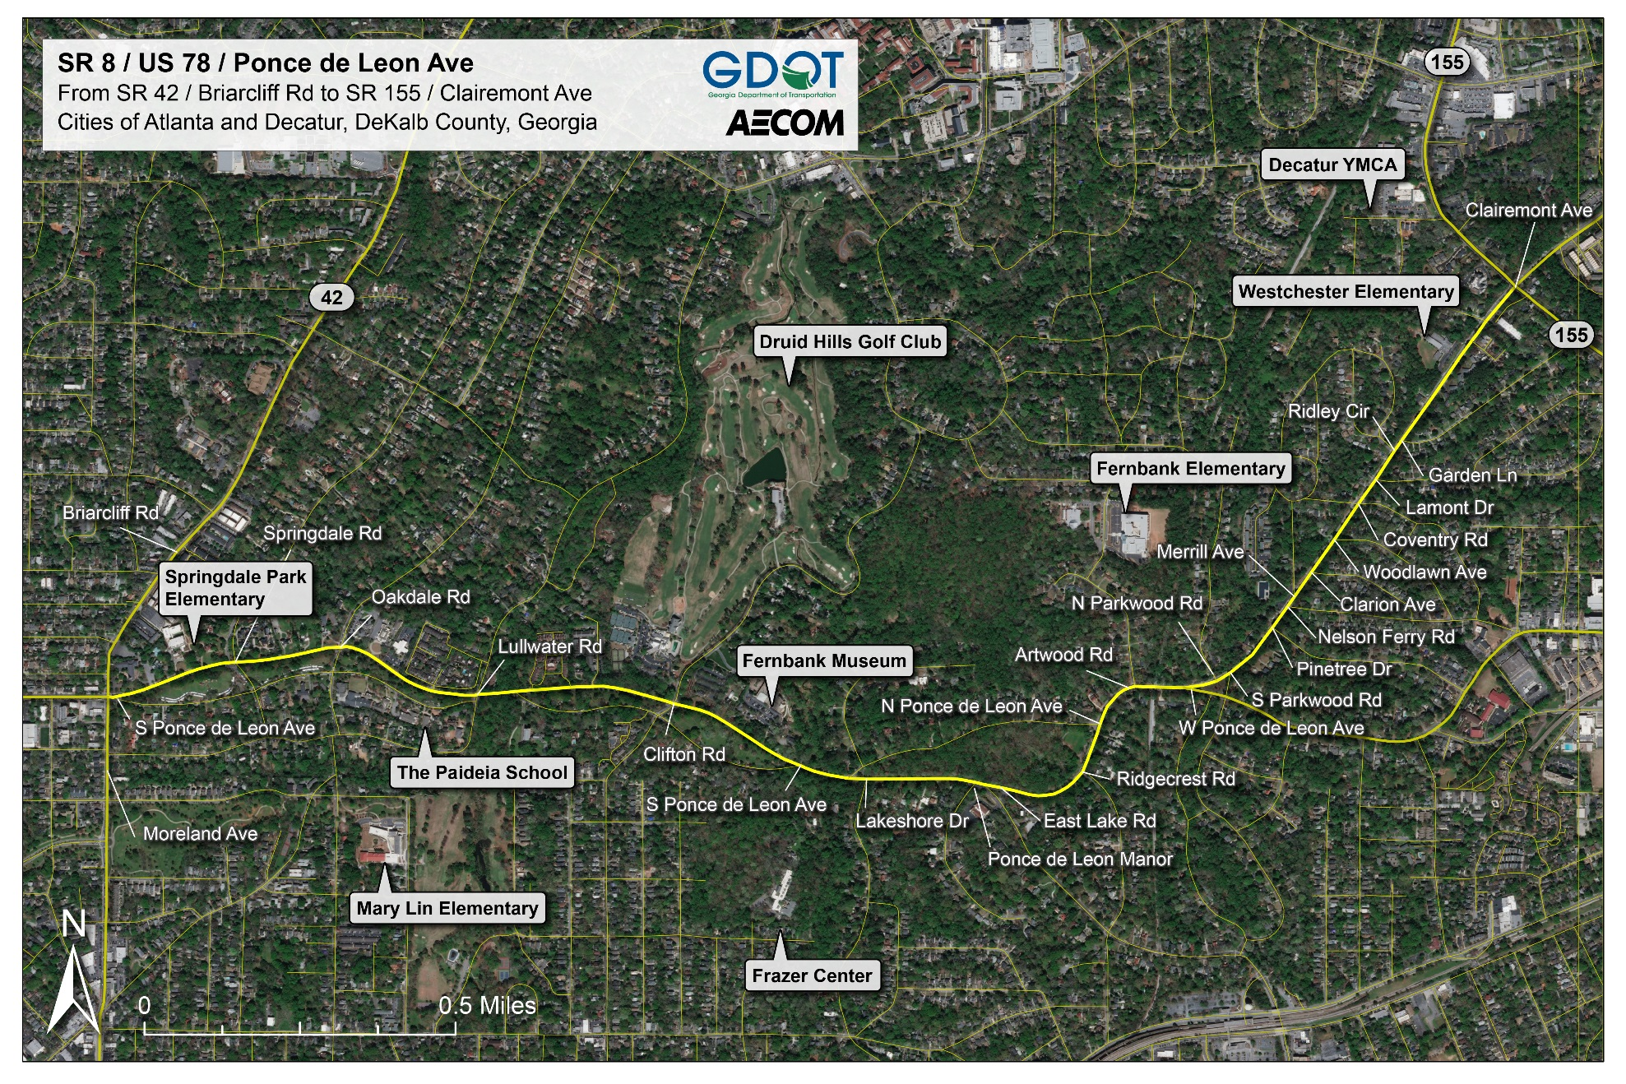
SR 8 / Ponce de Leon Avenue @ Ponce de Leon Manor / E Lake Rd

Slide 10
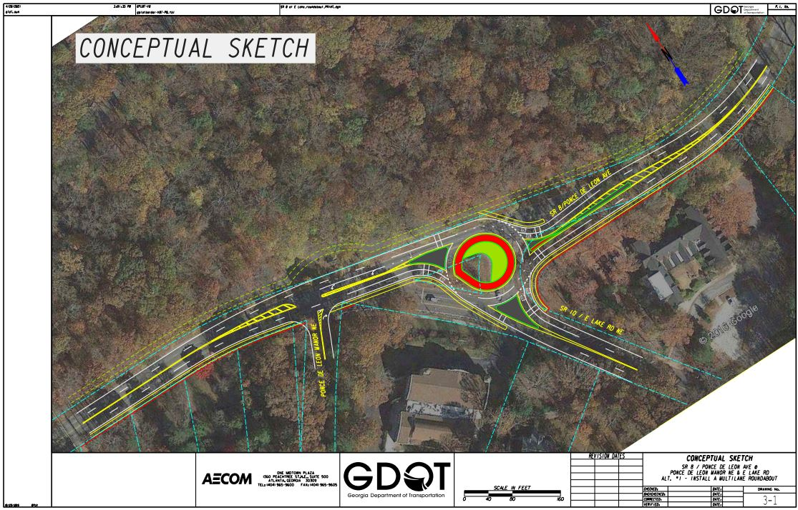
SR 8 / Ponce de Leon Avenue @ Ponce de Leon Manor / E Lake Rd Convert Ponce de Leon Manor to Stop Control and add Multi-lane roundabout at E Lake Rd

Slide 11
SR 8 / Scott Blvd from W Ponce De Leon Ave to E Parkwood Rd

Slide 12
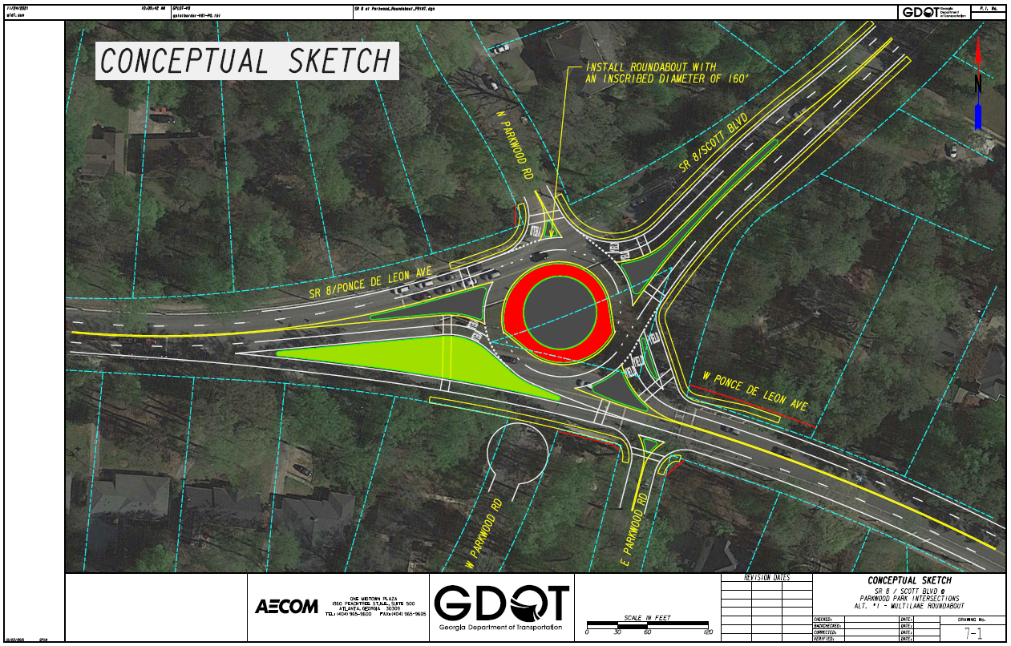
SR 8 / Scott Blvd from W Ponce De Leon Ave to E Parkwood Rd Multi-lane Roundabout; Remove the north leg and have RIRO at the intersection of W Ponce De Leon Ave and E Parkwood Rd. Make W Parkwood Rd a cul-de-sac

Slide 13
SR 8 / Ponce de Leon Avenue Quick Response Projects

Slide 14
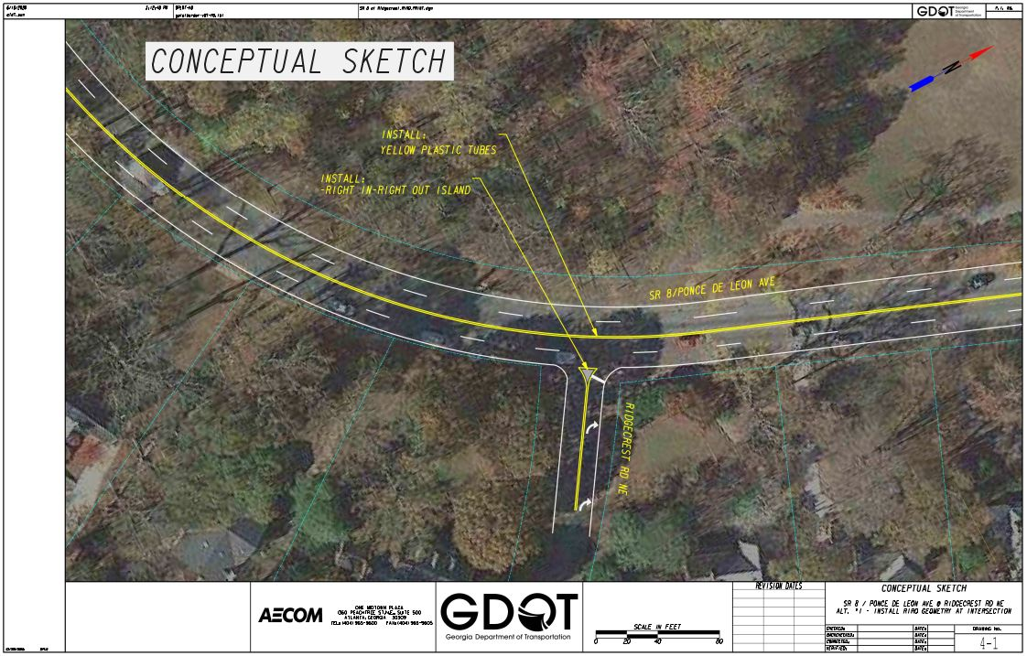
SR 8 / Ponce de Leon Avenue @ Ridgecrest Rd Right-in right-out

Slide 15
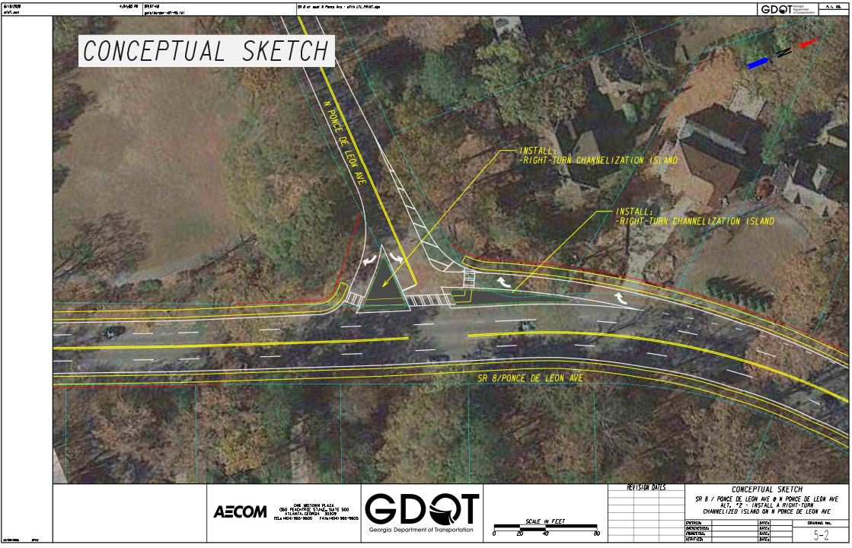
SR 8 / Ponce de Leon Avenue @ N Ponce de Leon Ave Add channelized right-turn movement along N Ponce de Leon Ave

Slide 16
Thank You for Attending For more information: Zeb Martin, GDOT zmartin@dot.ga.gov

